Slide 1

AI-Powered Professional Resume Builder
Welcome to the AI-Powered Professional Resume Builder project! Our web application helps you build a professional resume using an intuitive, form-based interface.
🗿 By Error 404

Slide 2
AI Skills or Obsolete Careers: Why Your Resume is the First Battlefield
AI Literacy = Job Security: Outpace Peers or Risk Replacement
In today's AI-driven era, mastering artificial intelligence is no longer optional—it's survival. Professionals who harness AI tools skyrocket their productivity, leaving peers struggling to keep up. But here's the catch: even if you're AI-savvy, your skills mean nothing without opportunities. The job market is ruthless—if your resume fails to impress, you'll stay invisible. Worse, if a colleague leverages AI to craft a flawless resume while yours gathers dust, they'll seize the interview slot meant for you. The first battle isn't just about knowing AI—it's about proving you do.
Resumes Decide Your Fate: Let AI Craft Yours to Win the Interview War
Your resume isn't a document—it's your ticket to the interview room. Hiring managers spend mere 6-8 seconds scanning resumes. A weak one? Straight to the trash. That's where our AI Resume Builder steps in. Designed to outsmart applicant tracking systems (ATS) and human biases, it auto-generates crisp, keyword-optimized content, formats professionally, and highlights your AI-driven edge. This tool ensures your resume isn't just seen-it's unforgettable. In a world where AI decides who thrives, let it work for you, not against you.

Slide 3
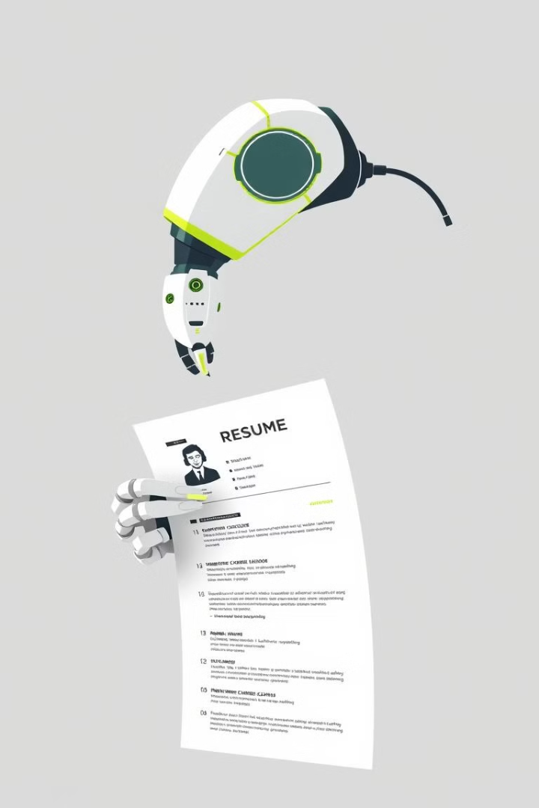
Common Resume Building Pitfalls
Many job seekers find resume creation challenging due to difficulties in formatting, articulating their value, and avoiding common mistakes. A poorly written resume can significantly hinder their chances of landing an interview.
Our AI-Powered Resume Builder addresses these issues, offering an intuitive platform that guides users through each step to create a professional and effective resume.

Slide 4
Challenges in traditional resume creation
1
Formatting Inconsistencies
2
Lack of Professional Guidance
Manual formatting can lead to a visually unappealing resume.
Traditional methods often lack guidance on effective content presentation.
3
Time-Consuming Process
4
Difficulty in Articulating Skills
Manual resume building is lengthy and tedious.
Struggling to compellingly present skills and experience.

Slide 5
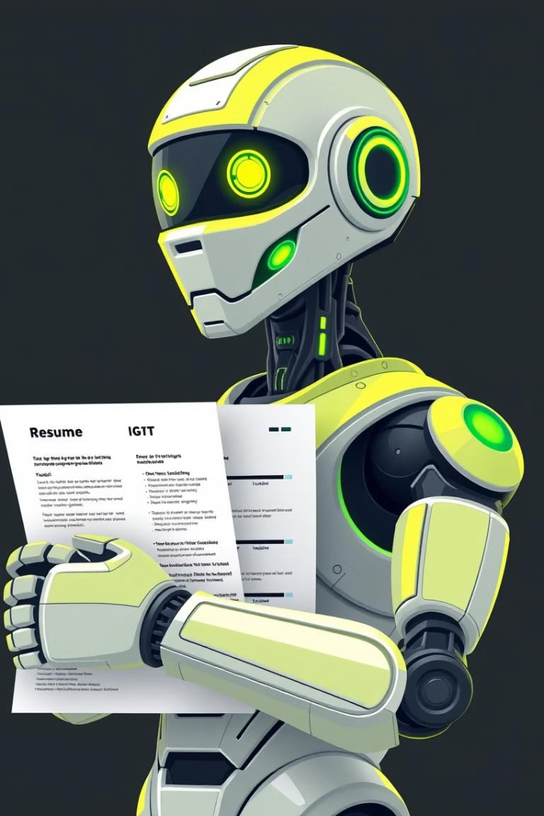
Unlocking Your Potential: Key Features of Our AI Resume Builder
1
AI-Powered Autofill
Smart suggestions for each resume section.
2
Resume Preview
See a real-time preview of your resume.
3
Customization Options
Customize resume layout and formatting.
4
Export and Print
Export your resume in various formats.

Slide 6





Resume Creation Workflow
Login
Users begin by logging into their accounts. They will use existing credentials or create a new account.
Data Entry
Users enter their job history and education data. They can also add skills and other relevant information.
AI Autofill
AI autofills resume sections. This feature saves users time and generates compelling content.
Customization
Users customize their resume. They can adjust layouts.
Export
Users export the completed resume. They can choose from multiple file formats.

Slide 7

No Experience? No Problem: Built for Everyone
Traditional resume builders overwhelm with complexity. Our builder prioritizes simplicity and user experience.
Featuring guided steps, AI tooltips, and a clean layout for first-time users.
AI Autofill provides one-click functionality. Resume building is as intuitive as texting.

Slide 8
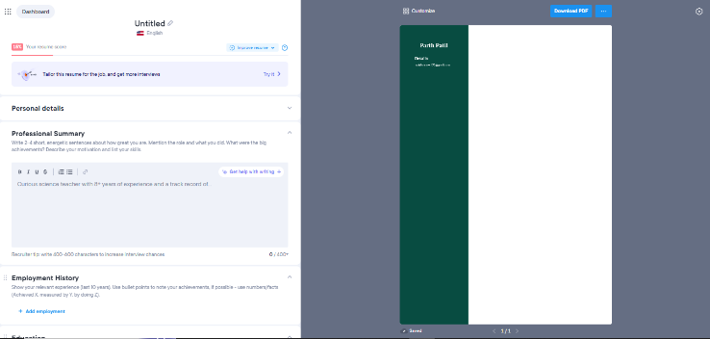
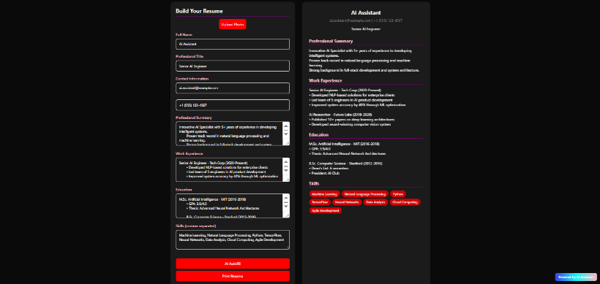
Clutter vs. Clarity: Why Our UI Dominates
Competitor’s UI
Our AI Resume Builder
❌ Overwhelming menus
✅ Clean, labeled sections
❌ Manual data entry
✅ One-click AI Autofill
❌ Desktop-only design
✅ Mobile-first responsiveness

Slide 9
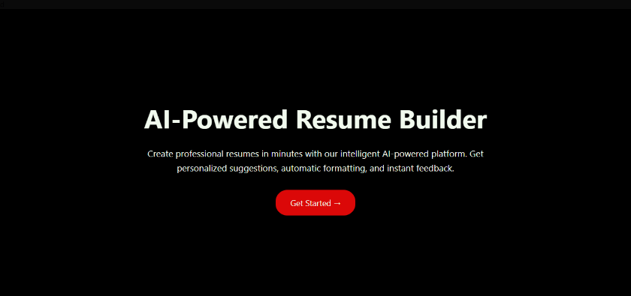

First Impressions Matter: Seamless Onboarding
Get Started Page (Home):
Sign-In Page:
A bold, distraction-free gateway.
Secure, frictionless entry.
Striking hero section with AI Resume Builder branding.
Clean modal overlay with dark theme for focus.
Minimalist design: Title, tagline, and a single red CTA button (‘Get Started’).
Two-field simplicity: Email + password (no clutter).
Instant access: Valid credentials → direct to resume builder.
Purpose: Eliminate decision fatigue. Users focus on one action.
Security highlight: Encrypted sign-in process.
Less typing, more doing: From homepage to builder in 2 clicks. No menus, no confusion—just progress.

Slide 10

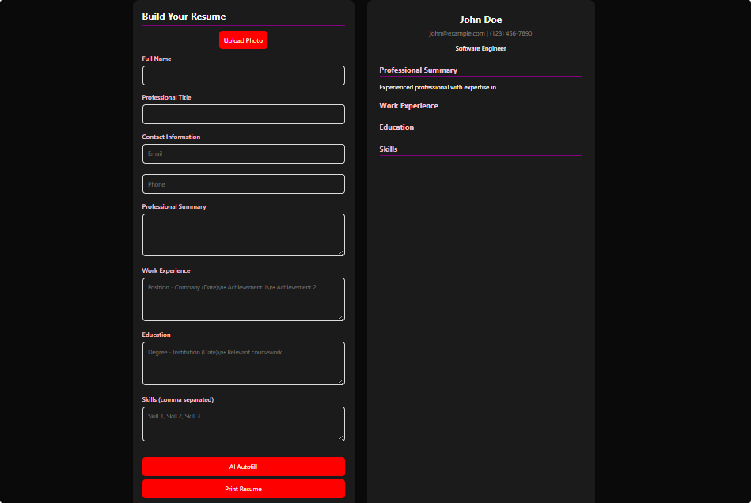
Smart Editing, Smarter Results
Powered by HTML5 and JavaScript. The resume builder uses <section class="input-section"> and <section class="resume-preview">.
User inputs (via <input> and <textarea> tags) trigger updateResume(). It dynamically renders changes in <div id="resumeName">.
The <button onclick="autofillAI()"> injects AI content. <input type="file"> and FileReader() handle photo previews.
Each feature works without page reloads. The app blends technical precision with intuitive design for seamless resume crafting.

Slide 11
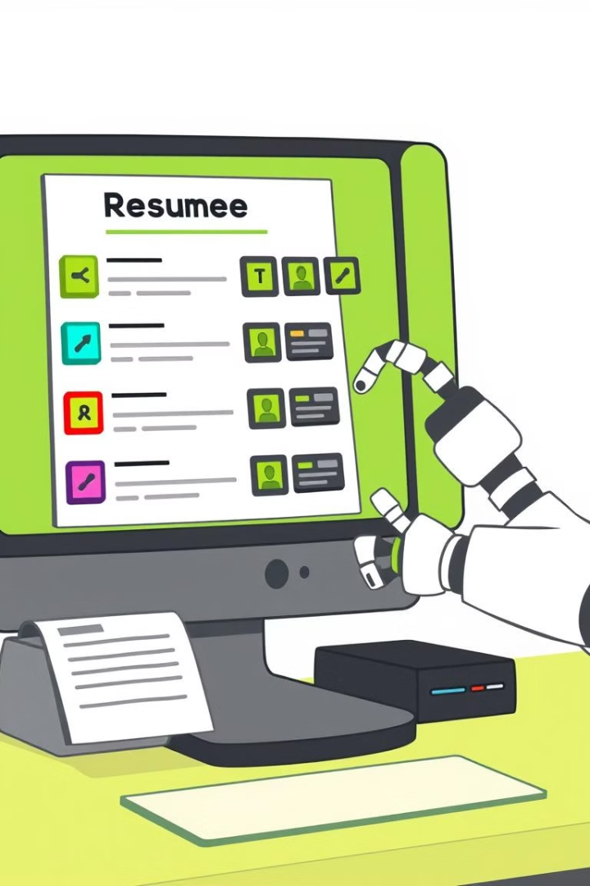
Future Enhancements
1
More Templates
2
AI Job Recommendations
Expand resume options with diverse, professional templates. Tailor resumes to various industries and roles.
Get AI-driven job suggestions that match your skills and goals. Focus your job search.
3
PDF Export
Download resumes in PDF format. Customize designs to make your resume unique.

Slide 12

Conclusion & Q&A
Thank you for exploring our AI Resume Builder.
We presented an innovative tool to make resume creation efficient and effective.
1
Key Highlights
2
User Experience
AI integration for smart content generation.
Intuitive design ensures accessibility.
3
Cross-Platform
Fully responsive across devices.

Slide 13

Our Team
Aaditya: App Structure (HTML)
Parth: UI/UX Design (CSS)
Harsh: Dynamic Features (JavaScript & AI)
Harshal: Presentation & Docs

